Slide 1

Case Study 5.6: Scrub Daddy
By George Redden

Slide 2
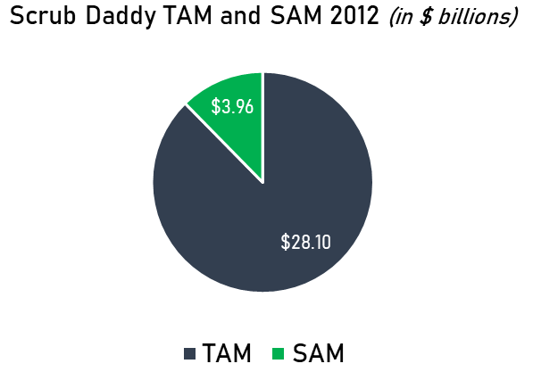
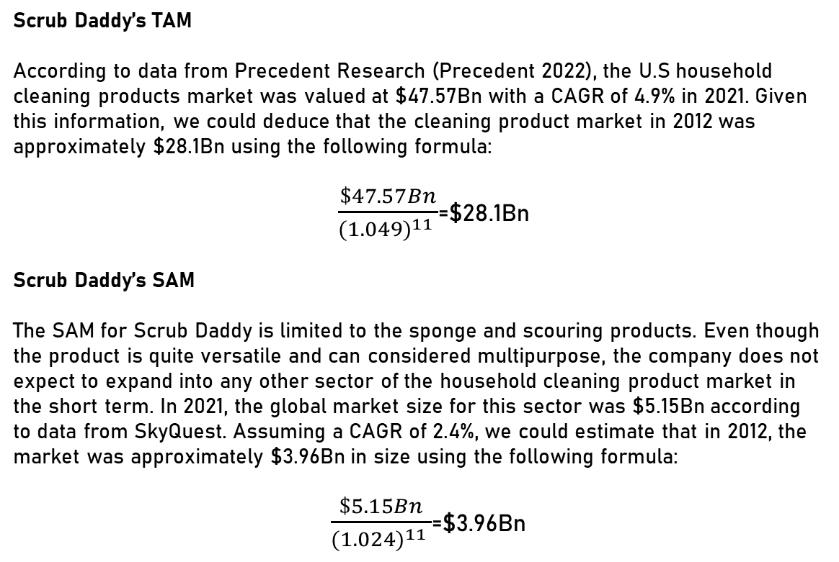
Doing your own research, evaluate the TAM, SAM (US) and SOM for Scrub Daddy with three typical scenarios of the VC method (from the October 2012 perspective).
Company’s fact sheet:
Scrub Daddy’s TAM
According to data from Precedent Research (Precedent 2022), the U.S household cleaning products market was valued at $47.57Bn with a CAGR of 4.9% in 2021. Given this information, we could deduce that the cleaning product market in 2012 was approximately $28.1Bn using the following formula:
$\frac{\$47.57Bn}{{(1.049)}^{11} }$=$28.1Bn
Scrub Daddy’s SAM
The SAM for Scrub Daddy is limited to the sponge and scouring products. Even though the product is quite versatile and can considered multipurpose, the company does not expect to expand into any other sector of the household cleaning product market in the short term. In 2021, the global market size for this sector was $5.15Bn according to data from SkyQuest. Assuming a CAGR of 2.4%, we could estimate that in 2012, the market was approximately $3.96Bn in size using the following formula:
$\frac{\$5.15Bn}{{(1.024)}^{11} }$=$3.96Bn
There are 2 types of sponges: polymer & steel. CAGR: 4.6% in 2021. Scrub Daddy would compete in a mature market against multi–nationals like 3M. The company currently operates in 3 retailer shops in Pennsylvania.

Slide 3
Doing your own research, evaluate the TAM, SAM (US) and SOM for Scrub Daddy with three typical scenarios of the VC method (from the October 2012 perspective).
Scrub Daddy’s SOM
Thanks to the product’s ability to compete with both polymer and steel sponges, the product’s SOM is wider than that of other conventional sponges. Furthermore, in the video, it was specified that Scrub Daddy’s guaranteed sales for the upcoming year would come from QVC and 3,000 grocery stores that the founder had an agreement with. These 3,000 grocery stores represented 4.61% of the total grocery market or $183M in potential sales from the US market ($3.96Bn/4.61%) Finally, in the video, the founder stated that sales from QVC in the prior year had been $100,000 and expected to grow. With this information, we can thus create 3 different scenarios:
 | Worst-Case Scenario | Base-Case Scenario | Best-Case Scenario
SOM | Sales peaking at $9.3M per year by year 3. | Sales peaking at $40.5M by year 3. | Sales peaking at $70M per year by year 3.
Explanation: | In the worst-case scenario, scrub daddy is only able to capture 5% of the sponge grocery market in 3,000 grocery stores while revenues from QVC only increase by 30%. | In the base case scenario, the company is able to capture 1% of the sponge market in the USA and increase it’s QVC sales by 50%. This rapid expansion in the national market is expected after accepting Lori Greiner’s offer. | In the best-case scenario, the company would capture 2% of the total sponge market in the U.S and double its QVC sales. This would be a lofty goal given the small size of the company and the hefty price of each of the sponges.

Slide 4
Compare the financing options presented to Aaron Krause in the video. Projecting the business in the future and depending on the possible scenarios (‘back of the envelope’ projections), what are the pros and cons of each offer, for Aaron and for the investor?
Offers
Mark Cuban
Kevin O’Leary
Lori Greiner
Robert Herjavec
Daymond John
No offer
No equity. $100,000 investment. For every product sold $.25 cents until debt paid off, then $.075 cents onwards.
$200,000 at 20% for a post-money valuation of $1,000,000.
No offer
$175,000 at 25% for a post-money valuation of $700,000.
Projections based on productions costs of $1 per unit and sales price of $2.8 per unit. Sales of 5, 10 and 15 million units in year 1 ,2, and 3 respectively.

Slide 5
Compare the financing options presented to Aaron Krause in the video. Projecting the business in the future and depending on the possible scenarios (‘back of the envelope’ projections), what are the pros and cons of each offer, for Aaron and for the investor?
Analysis of offers from Krause’s perspective
 | Kevin O’Leary | Lori Greiner | Daymond John
Pros | The main incentive to accept this offer is that Aaron Krause, the founder of Scrub Daddy, would keep full ownership of the company. In addition, it would require the lowest pay-out amount from each of the offers as $.075 cents would only comprise roughly 2.7% of the price per unit of the product. | This offer would double the founder’s initial investment request while providing key connections in the sector to promote the product. From the start, it seemed obvious that Lori was focused on long-term growth as her final offer of $200,000 for a product that, until then, had generated only $100,000 in revenues seemed quite risky. In short, her offer would provide: $200,000 investment Brand awareness Expertise and guidance Distribution and marketing contacts | Similar to Lori’s offer but without the commitment to help the company have access to key retailers and distributors. This could be an interesting offer if Krause were looking for a hands-off-approach investor.
Cons | The main drawback from this offer is that it would add a steep increase to the fixed costs of the product, specially during the repayment of the loan. Although the gross margin of the product is quite high, $1.8 per unit or 180%, with the added fixed costs, the margin would go down by roughly 25%. This could hamper the company’s ability to remain competitive and use the extra revenue to reinvest during the company’s crucial growth period. | The main drawback from this offer is that Krause would have to give up a significant amount of equity to have access to the $200,000 investment. 20% would be double the amount he was willing to offer, which would result in large pay-out amounts from all the profits generated by the company. Also, there could be pressure for rapid growth and potential pressure to change the company’s strategy. Thus, it would be important for Krause to consider the level of involvement that Lori will have in the company’s future. | This would be the worst offer out of the three options as it would not match Lori’s $200,000 investment and would require Krause to give up 25% of the company’s equity. This would result in very large pay-out amounts from the profits generated by the company.

Slide 6

Compare the financing options presented to Aaron Krause in the video. Projecting the business in the future and depending on the possible scenarios (‘back of the envelope’ projections), what are the pros and cons of each offer, for Aaron and for the investor?
Analysis of offers from each investor’s perspective
Kevin O’Leary
Lori Greiner
Daymond John
Pros: The investment would be repaid with royalties. In simple terms, the $100,000 investment would be repaid with the revenues, not the profits, lowering the risk of non-payment. Also, royalties would guarantee payments for as long as the company is in existence.
Cons: No access to equity and lower payouts. In addition, O’Leary would not have the ability to have a say in the company’s decisions as he would have no ownership.
Pros: Lori would gain access to 20% of the company. This would not only provide her with a significant share of the profits but would also allow her to have significant input on the company’s decisions.
Cons: Lori would have a higher risk since she would not see her investment repaid until the company begins to post profits or finds an exit to liquidate her investment.
Pros: Same as Lori, but with even a more significant share of the equity.
Cons: Higher risk as the return on his investment is tied to the company’s profits. Were the company to become insolvent, he would lose his investment.
From the offers made to Krause, it becomes clear why he chose Lori to invest in the company. Not only would she bring double the amount he had requested, but also, she would bring expertise and guidance to the company. In addition, her equity offer was lower than Daymond’s, who eventually withdrew from the bidding war. While O’Leary’s offer may be appealing as it doesn’t relinquish equity of the company, having to repay royalties can create difficulties for the company to draw new investors in the future . Also, as the company grows, the royalty pay-outs will have an impact on the company’s ROE, potentially decreasing the company’s valuation as the amount of retained earnings decrease. (Shafqat 2021) For a company like Scrub Daddy, this could hamper its ability to obtain funding in future rounds of investment.

Slide 7
If you had been a venture capitalist present that day, and assuming you would have wanted to compete for the investment, what could you have proposed to Aaron? Prepare a simple term sheet of your offer, a valuation of the business and a list of detailed exit options.
I would have offered the following terms:
Economic terms of the deal
Investment amount of $150,000 at 15% resulting in a post-money valuation of $1,000,000 and pre-money valuation of $850,000. The dilution of existing shareholders would be 15%
Liquidation terms: 1x participating preference. (This could be negotiable to capped or non-participating)
Narrow-based weighted average anti-dilution clause.
Control and organization
Board structure of 4 to 7 members with a 2-1 structure.
Dividends of 6% non-cumulative
Voting rights equal to the number of common shares.
Tag-along rights
Exclusivity and cost terms
No shop clause valid for 30 days.
Reimbursement of all legal and fees if founders pull out of the deal up to $20,000.
ROFR (right of first refusal) clause.
Valuation
Investment of $150,000 at 15%
Post-money Valuation: $1,000,000
Pre-money valuation: $850,000
Dilution of shareholders: 15%

Slide 8
Sample of the term sheet to invest in Scrub Daddy
Company: | George Redden Ltd.
Securities: | Series A Preferred Stock of the Company (“Series A”).
Investment Amounts: | $150,000 from George Redden (“Lead Investor”) Convertible notes and safes (“Convertibles”) convert on their terms into shadow series of preferred stock (together with the Series A, the “Preferred Stock”).
Valuation: | $1 million post-money valuation.
Liquidation Preference: | 1x non-participating preference. A sale of all or substantially all of the Company’s assets, or a merger (collectively, a “Company Sale”), will be treated as a liquidation.
Dividends: | 6% noncumulative, payable if and when declared by the Board of Directors.
Conversion to Common Stock: | At holder’s option and automatically on (i) IPO or (ii) approval of a majority of Preferred Stock (on an as-converted basis) (the “Preferred Majority”). Conversion ratio initially 1-to-1, subject to standard adjustments.
Voting Rights: | Approval of the Preferred Majority required to (i) change rights, preferences or privileges of the Preferred Stock; (ii) change the authorized number of shares; (iii) create securities senior or pari passu to the existing Preferred Stock; (iv) redeem or repurchase any shares (except for purchases at cost upon termination of services or exercises of contractual rights of first refusal); (v) declare or pay any dividend; (vi) change the authorized number of directors; or (vii) liquidate or dissolve, including a Company Sale. Otherwise votes with Common Stock on an as‑converted basis.
Drag-Along: | Founders, investors and 1% stockholders required to vote for a Company Sale approved by (i) the Board, (ii) the Preferred Majority and (iii) a majority of Common Stock [(excluding shares of Common Stock issuable or issued upon conversion of the Preferred Stock)] (the “Common Majority”), subject to standard exceptions.
Other Rights & Matters: | The Preferred Stock will have standard broad-based weighted average anti-dilution rights, first refusal and co-sale rights over founder stock transfers, registration rights, pro rata rights and information rights. Company counsel drafts documents. Company pays Lead Investor’s legal fees, capped at $30,000.
Board: | Lead Investor designates 1 director. Common Majority designates 2 directors.
Founder and Employee Vesting: | Founders: Aaron Krause Employees: 4-year monthly vesting with 1-year cliff.
No Shop: | For 30 days, the Company will not solicit, encourage or accept any offers for the acquisition of Company capital stock (other than equity compensation for service providers), or of all or any substantial portion of Company assets.

Slide 9
Exit options for the investor
IPO (Initial public offering)
Stock buybacks or secondary sale
M&A deals.
Liquidation
If the company fails to take off, there’s the option to liquidate its assets and distribute the proceeds to investors. Having chosen a 1x participating clause, it would mean that the investor would have preference to get its investment money back plus 15% of the remaining value left from the liquidation.
Another exit strategy would be to sell the investor’s stake back to the company. In particular, preferred stocks can have clauses like redemption rights or premiums that facilitate the exit of investors from the company.
Exit options for the investor:
Investors can liquidate their stake at a company after an IPO. Once the company becomes traded in the public stock market, the investor can sell their stocks in the market.
If the company is acquired the investor will either receive the option to get stocks from the acquiring company or will be bought out by the purchasing company at a established stock price.

Slide 10

As the main investor in Scrub Daddy in 2012, how are you going to support Aaron’s venture in the next few years?
Develop a sound business model and support moves strategy.
Although from the video it’s evident that the founder prefers a hands-off approach to running his business, I would ensure that the company had a proper strategy implemented. For instance, aside from having a clear business canvas model, Scrub Daddy should have clearly defined support moves to reinforce sales of its products. The following table represents an example of the strategic moves that the company should take into consideration.
Strategy/supporting move | Internal | Acquisitions | Formal alliance | Ecosystem approach
Reinforce current business model | Develop a product line that can complement the main product. (Scrub family product line) | Buy plants/warehouses so product and key technology remains insourced. | Introduce product through partnerships with major retailers like Walmart and Amazon. | Take advantage of the publicity gained from Shark Tank to expand the company’s presence on social media.
Gain access to adjacencies | Develop products like soap dispensers that can help the company grow and diversify its source of revenue. | Look into the options of buying other cleaning product companies that can complement Scrub Daddy’s product lineup. | Create partnerships with other cleaning companies to offer cleaning kits. | -
Prepare for disruption | Develop new types of sponges for different purposes like BBQ cleaners. | Look into the option of acquiring innovative cleaning products like Scrub Daddy. | Partner with international manufacturers to launch the product in new markets. (example of Scrub Daddy in Germany) | Introduce new products by having viral campaigns on platforms like Tik Tok.

Slide 11



As the main investor in Scrub Daddy in 2012, how are you going to support Aaron’s venture in the next few years?
2. Introduce the company to key players from large retailers and distributors.
In retrospect, one of the key reasons for Scrub Daddy’s success was the speed in which the its product was able to reach most retailers in the US and Germany. This was thanks to both Krauser’s dedication and refusal to allow his company to become an infomercial product (Feloni 2015) and Greiner’s expertise and access to key networks to push the brand awareness.
3. Be available to listen and discuss the company’s new ideas.
One key reason for the company’s success was Greiner’s constant support and disposition to follow Krause’s vision for the company. As a result, there were no clashes in vision and the company quickly thrived.
4. Provide guidance in the company’s future investment decisions.
One key role for the main investor is to provide guidance and support to the company’s investment decisions. When Scrub Daddy had a meeting to expand its capacity in Germany, Greiner was present with Krause to discuss the terms of the investment. This kind of support allows the company to run smoothly and build credibility. (ABC 2016)

Slide 12
References
Precedent Research 2022. https://www.precedenceresearch.com/household-cleaning-products-market
SkyQuest 2023. https://www.skyquestt.com/report/sponge-and-scouring-pads-market
Shafqat. 2021. “Are Royalty Deals Bad or Good For Start-Ups, Small Businesses, or Even Larger Firms?” https://www.riskconcern.com/post/are-royalty-deals-bad-or-good-for-start-ups-small-businesses-or-even-large-firms
Feloni, Richard. 2015. “How a sponge company became the biggest 'Shark Tank' success story, with over $50 million in sales.” https://finance.yahoo.com/news/sponge-company-became-biggest-shark-142100923.html
ABC. 2016 “Scrub Daddy meeting: Beyond the Tank.” https://www.youtube.com/watch?v=MEtNdEO-Jfg

